Slide 1

Ten Principles of Economics
P R I N C I P L E S O F
ECONOMICS
By: N. Gregory Mankiw

Slide 2
Chapter objectives:
To learn what Economics is all about?
What are the principles of how people make decisions?
What are the principles of how people interact?
What are the principles of how the economy works as a whole?

Slide 3

What ECONOMICS is all about?
SCARCITY is the situation that exists because wants are unlimited and resources are limited
E C O N O M I C S is the study of how individuals and societies satisfy their unlimited wants with their limited resources.
Notes:
The word ECONOMY comes from the Greek word “OIKONOMOS” – one who manages a household

Slide 4



3 Basic Economic Questions:
1. WHAT to produce?
2. HOW to produce?
3. For WHOM to produce?

Slide 5
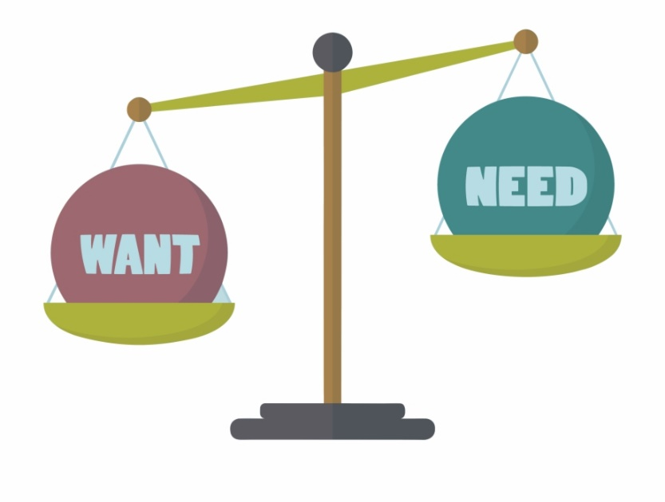
The principles of
How People Make Decisions

Slide 6
Principle no. 1:
PEOPLE FACE TRADEOFFS
!
All decisions involve tradeoffs.
> TRADE-OFF
it implies the exchange of one thing to get the another
what is given up to get what is wanted
the choices sacrificed

Slide 7
Principle no. 1:
PEOPLE FACE TRADEOFFS
Example:
Consider a student who must decide how to allocate her most valuable resource—her time. She can spend all of her time studying economics –
>> for every hour she studies economics, she gives up an hour she could have used studying other subject
>> and for every hour she spends studying, she gives up an hour that she could have spent napping, bike riding, watching TV, or going out with friends

Slide 8
Principle no. 1:
PEOPLE FACE TRADEOFFS
!
Society faces an important tradeoff:
efficiency vs. equity
when prosperity is distributed uniformly among society’s member
when society gets the most from its scarce resources
Notes:
In a society at any point of time all the resources would be relatively scarce. We cannot have whatever we want. We need to decide our priorities and then distribute the resources. In such situation we need to take into consideration goals of efficiency and equity.
Tradeoff: To achieve greater equality, could redistribute income from wealthy to poor. But this reduces incentive to work and produce, shrinks the size of the economic “pie.”

Slide 9
Principle no. 2:
THE COST OF SOMETHING IS WHAT YOU GIVE UP TO GET IT
>> Making decisions requires comparing the costs and benefits of alternative choices
>> The opportunity cost of any item is whatever must be given up to obtain it.
>> It is the relevant cost for decision making
Example:
The opportunity cost of going to college for a year is not just the tuition, books, and fees, but also the foregone wages

Slide 10
Principle no. 3:
RATIONAL PEOPLE THINK AT
THE MARGIN
Rational People
systematically and purposefully do the best they can to achieve their objectives.
make decisions by evaluating costs and benefits of marginal changes, incremental adjustments to an existing plan.
Example:
When a student considers whether to go to college for an additional year, he compares the fees & foregone wages to the extra income he could earn with the extra year of education

Slide 11
Principle no. 4:
PEOPLE RESPOND TO INCENTIVES
INCENTIVE something that induces a person to act, i.e. the prospect of a reward or punishment.
Ő Rational people respond to incentives.
Example:
When the gas prices rise, consumer takes public transportation

Slide 12

The principles of
How People Interact

Slide 13
Principle no. 5:
TRADE CAN MAKE EVERYONE
BETTER OFF
Rather than being self-sufficient, people can specialize in producing one good or service and exchange it for other goods.
Countries also benefit from trade and specialization:
Get a better price abroad for goods they produce
Buy other goods more cheaply from abroad than could be produced at home

Slide 14
Principle no. 6:
MARKETS ARE USUALLY A GOOD WAY TO ORGANIZE ECONOMIC ACTIVITY
Market: whereby buyers and sellers come in close contact with each other directly or indirectly to sell or buys goods and service (need not be in a single location)
A market economy allocates resources through the decentralized decisions of many households and firms as they interact in markets
“Organize economic activity” means determining:
• what goods to produce
• how to produce them
• how much of each to produce
• who gets them
Famous insight by Adam Smith in The Wealth of Nations (1776): Each of these households and firms acts as if “led by an invisible hand” to promote general economic well-being
Notes:
Adam Smith made the most famous observation in all of economics: Households and firms interacting in markets act as if they are guided by an “invisible hand” that leads them to desirable market outcomes
According to Adam Smith: wealth does not live in a vacuum and that people acting in their own interest will eventually act in the best interest of the greater public good
INVISIBLE HAND means that by following their self interest consumers and firms can create an efficient allocation of resources of the whole of society

Slide 15
Principle no. 6:
MARKETS ARE USUALLY A GOOD WAY TO ORGANIZE ECONOMIC ACTIVITY
The invisible hand works through the price system:
the interaction of buyers and sellers determines prices.
each price reflects the good’s value to buyers and the cost of producing the good.
prices guide self-interested households and firms to make decisions that, in many cases, maximize society’s economic well-being.

Slide 16
Principle no. 7:
GOVERNMENT CAN SOMETIMES IMPROVE MARKET OUTCOMES
Two broad reasons for a government to intervene in the economy: (1) to promote efficiency and (2) to promote equity.
Some reasons that can cause market failure:
Externalities, when the production or consumption of a good affects bystanders (e.g. pollution)
Market power, the ability of a single economic actor (or small group of actors) to have a substantial influence on market prices
Market failure: a situation in which a market left on its own fail to allocate resources efficiently

Slide 17
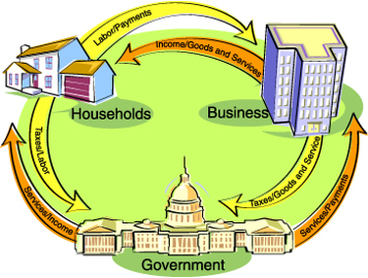
The principles of
How Economy as a
Whole Works

Slide 18
Principle no. 8:
A COUNTRY’S STANDARD OF LIVING DEPENDS ON ITS ABILITY TO PRODUCE GOODS
AND SERVICES
The most important determinant of living standards: productivity, the amount of goods and services produced per unit of labor.
Productivity depends on the equipment, skills, and technology available to workers.

Slide 19
Principle no. 9:
PRICES RISE WHEN GOVERNMENT PRINTS TO MUCH MONEY
Inflation an increase in the overall level of prices in the economy
When government prints large quantities of the nation’s money, the value of the money falls
!
What causes inflation?
---growth in the quantity of money
Did you know?
Notes:
Prices go up to reflect the amount of money being printed. While the more money makes people think they’re wealthier, inflation causes prices to go up and that money loses some of its value

Slide 20
Principle no. 10:
SOCIETY FACES A SHORT-RUN TRADEOFF BETWEEN INFLATION AND UNEMPLOYMENT
>> In the short-run (1 – 2 years), many economic policies push inflation and unemployment in opposite directions.
Phillip’s Curve
a curve that shows the short-run tradeoff between inflation and unemployment

