Slide 1
Basic Economic models

Slide 2
Basic Economic models
The Circular Flow Model
The Production Possibilities Frontier

Slide 3
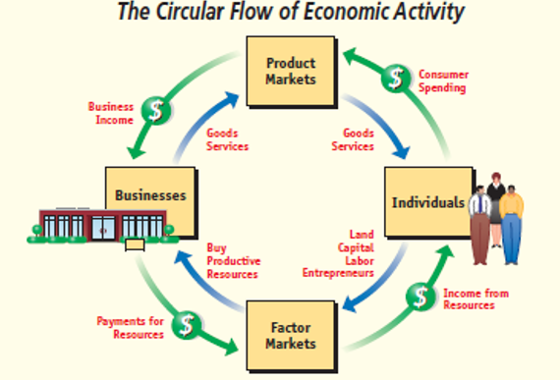
Legend:
Flow of inputs and outputs
Flow of dollars (money)
Circular flow Model – a model that shows how goods, resources, and dollars (money) payments flow between households and firms.
Outer loop of the diagram shows money flows
Inner loop of the diagram shows the flow of goods and resources, and the market in which they are traded.
Figure 1

Slide 4
Legend:
Flow of inputs and outputs
Flow of dollars (money)
Business/ Firm
Produce and sell goods and services
Hire and use factors of production
Household
Buy and consume goods and services
Own and sell factors of production
Product Market
Firms sell
Household buy
Factor Market
Households sell
Firms buy

Slide 5
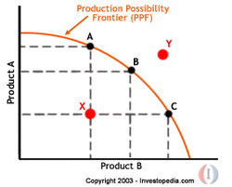
Production Possibilities Frontier (PPF)
>> It is a curve showing all the combinations of two goods that can be produced with the resources and technology currently available.
Note:
Point/s outside the frontier are not feasible given the economy’s resources
Point/s inside the frontier means that economy is producing goods and services inefficiently

